Slide 1
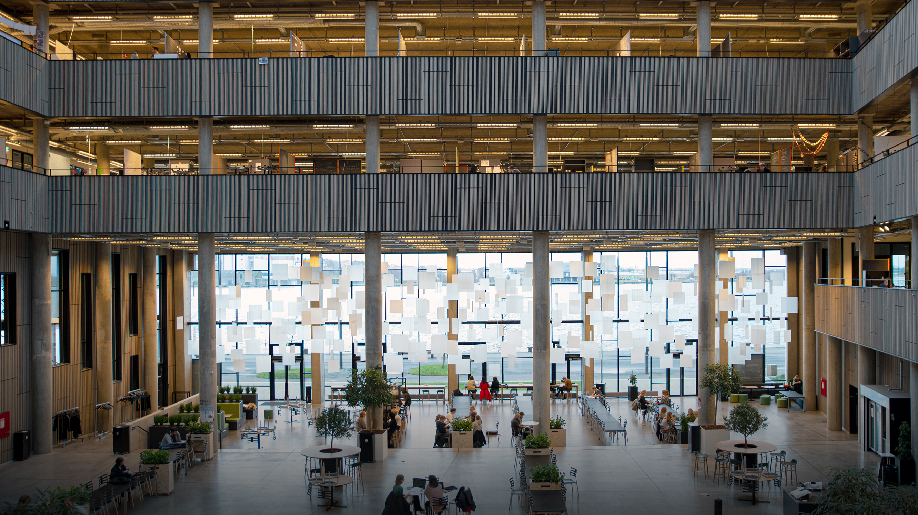

LLM enabled Network Analysis of EU Debates 14.11.2025
Faraiba Farnan Tabinda, Melika Shokri, Sören Kinch-Jensen

Slide 2

Agenda
Agenda
Problem Statement
Dataset
Pipeline & Network Architecture
Analysis & Results
Limitations
Summary
Discussion

Slide 3
From Speeches to Networks: Understanding Discourse in the European Parliament.
Problem statement
“
How can we identify the main topics discussed by Members of the European Parliament (MEPs) and derive insights from inspecting the relationships between speakers, topics, and parties?
”
1
Which issues dominate parliamentary discussions?
How do political groups distribute their attention across issues?
2
3
Which MEPs connect otherwise separate political or thematic clusters?

Slide 4
EU-Debates data sets contains speeches ad interventions across languages
Dataset
Field | Example | Description
speaker_name | Claude Gruffat | Member of European Parliament
speaker_party | Greens/EFA | Political group
text, translated_text | Text paragraph | Speech transcript in english
speaker_role | Member of the European Parliament | Role of the speaker (e.g., MEP, EP President).
debate_title | Signature of acts | Title of the debate in the European Parliament
topics | [“climate”, “energy transition”] | Multiple topics (LLM-extracted)
primary_topic | “energy policy” | Dominant theme
language, date, year | fr, 2023-03-15, 2023 | Metadata

Slide 5
Our 5-Step pipeline leads to interpretable results
Pipeline & Network Architecture
1. Raw Text
2. LLM Topic
Extraction
3. Structured Dataset
4. KG & Network Construction
5. Analysis
EU debate transcripts
Sample of 500 speeches in 2023
Gemini 2.5 model API asked to extract
1–3 concise topics (noun phrases, lowercase)
1 primary topic per speech.
Perform a clustering for the topics
Speaker
Party
Topics
Primary Topics
Cluster
Speaker-Cluster
Party-Cluster
Speaker-Speaker
Degree Centrality
Betweenness Centrality
Closeness Centrality

Slide 6
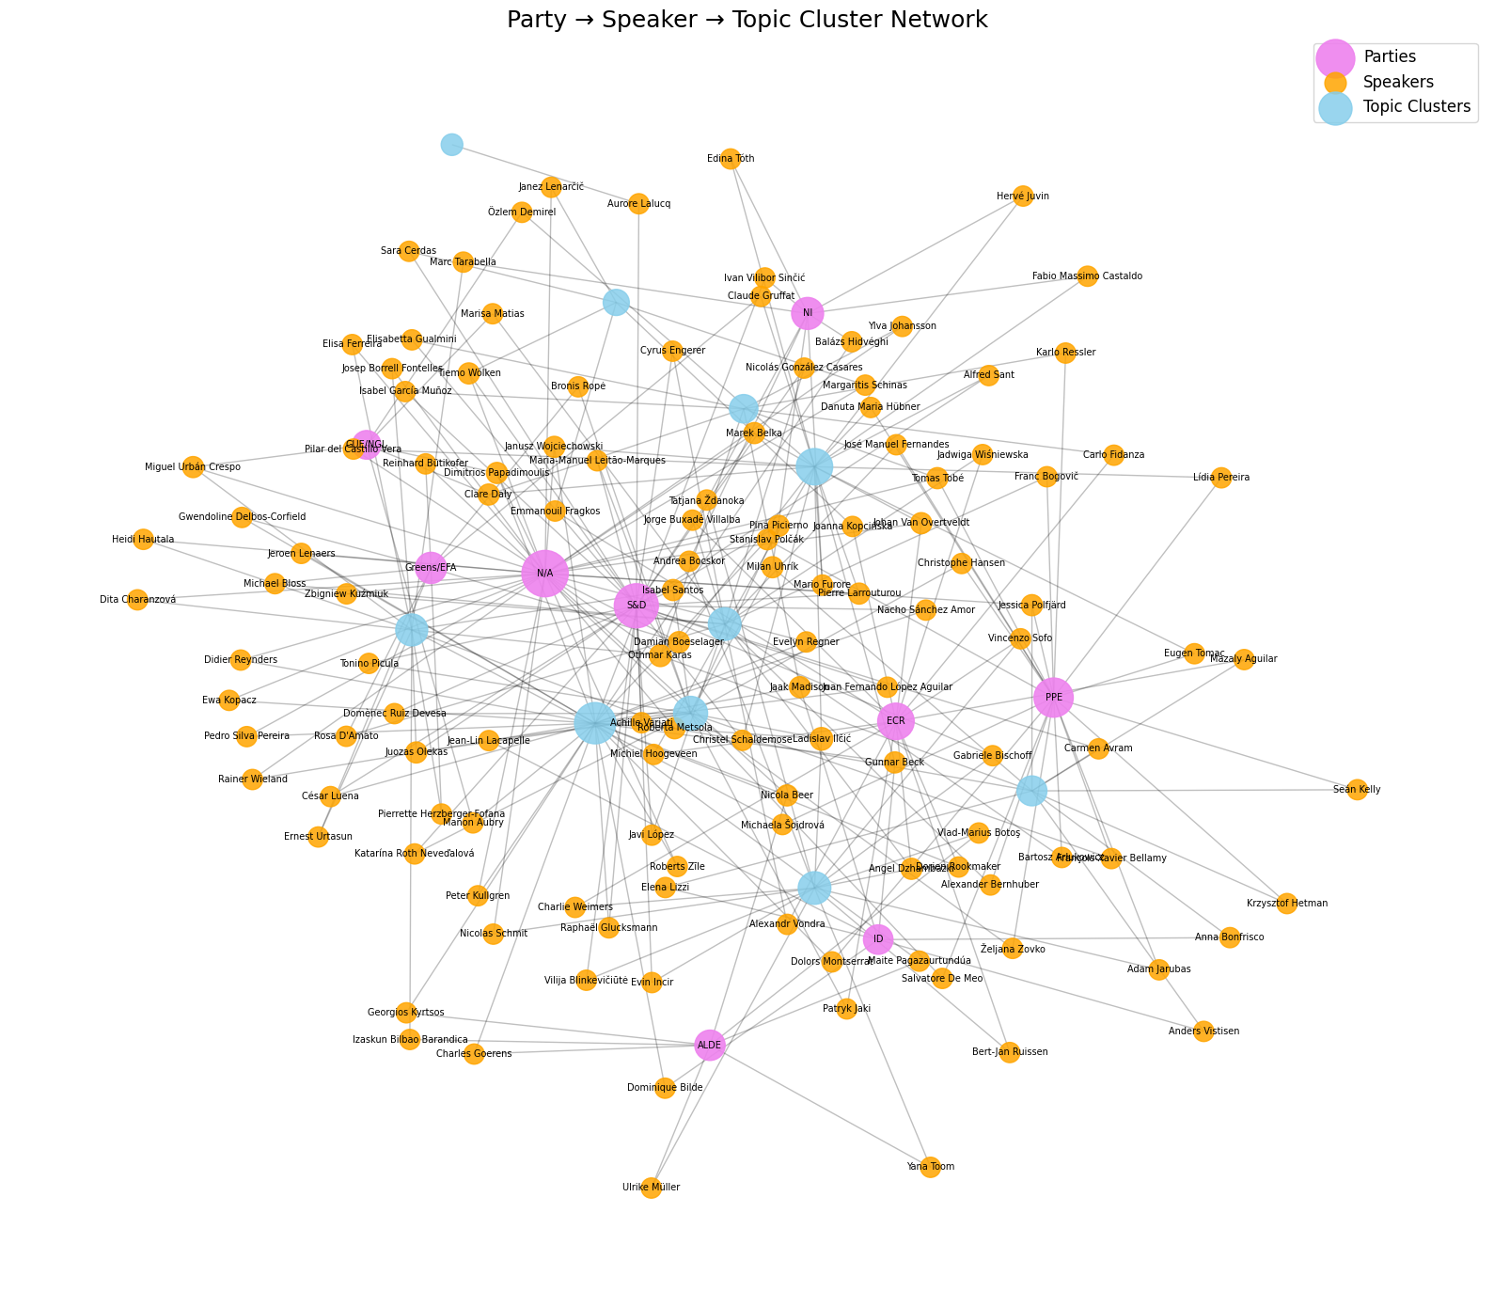
Overall Network
Pipeline & Network Architecture
Nodes
Speakers
Parties
Topics
Edges
Spoke about
Belongs to
Shares topics with
Core Networks
Speaker-Cluster
Party-Cluster
Speaker-Speaker
Notes:
The Party → Speaker → Topic Cluster knowledge graph reveals how political communication flows inside the European Parliament. It shows which parties are most active, which speakers dominate the thematic landscape, and which high-level issues drive the majority of debates. It also highlights structural bridges between political camps and identifies central themes shaping the EU political agenda.

Slide 7
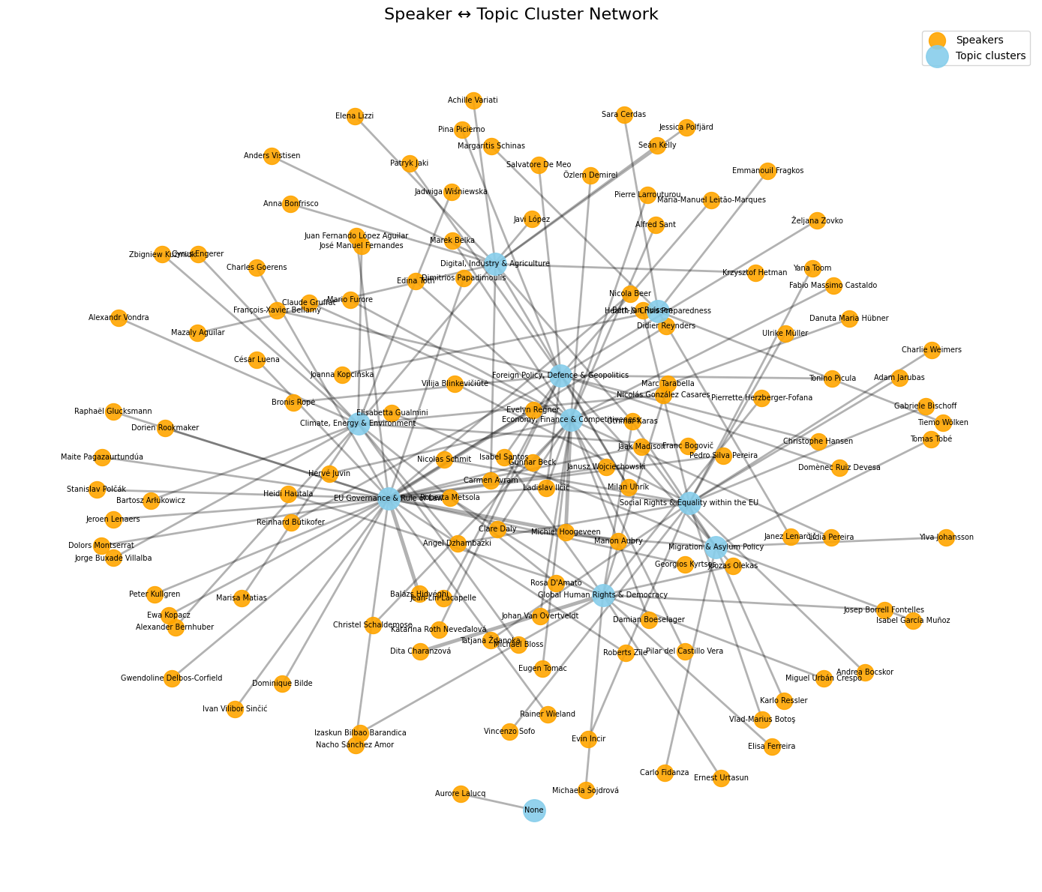
Who talks about what
Analysis & Results
What it represents
Bipartite graph connecting MEPs to LLM-derived topic clusters.
Edge = speaker discussed the topic at least once (weighted by frequency).
Key insights
A few highly active generalist MEPs dominate debate space – Ladislav Ilčić, Janusz Wojciechowski, Gunnar Beck, Roberta Metsola, Jaak Madison.
These figures score highest in degree, closeness, and betweenness centrality → broad thematic reach and “bridge” positions.
Core topics such as EU Governance & Rule of Law, Economy & Finance, and Foreign Policy act as central hubs linking most debates.
Notes:
Centrality analysis reveals clear structural patterns in the speaker–topic cluster network.
Degree and weighted degree show that Ladislav Ilčić, Othmar Karas and Roberta Metsola are the most active and broadly connected speakers, engaging across multiple thematic clusters.
Among topics, EU Governance & Rule of Law, Economy, Foreign Policy, and Social Rights emerge as the most widely discussed clusters.
Betweenness centrality identifies Ilčić and Angel Dzhambazki as key bridges in the debate space, connecting otherwise separate thematic clusters.
On the thematic side, Governance, Social Rights, and Foreign Policy act as major structural “hinge” topics linking various issue arenas.
Finally, closeness centrality highlights Ilčić, Metsola and Madison as globally central speakers with efficient reach across the network. Thematically, Governance, Foreign Policy, Social Rights and Economy are closest to all other clusters, underlining their centrality in European Parliamentary discourse.
Together, these measures show that a small set of MEPs and core issue clusters dominate and structure the 2023 EP debate network.

Slide 8
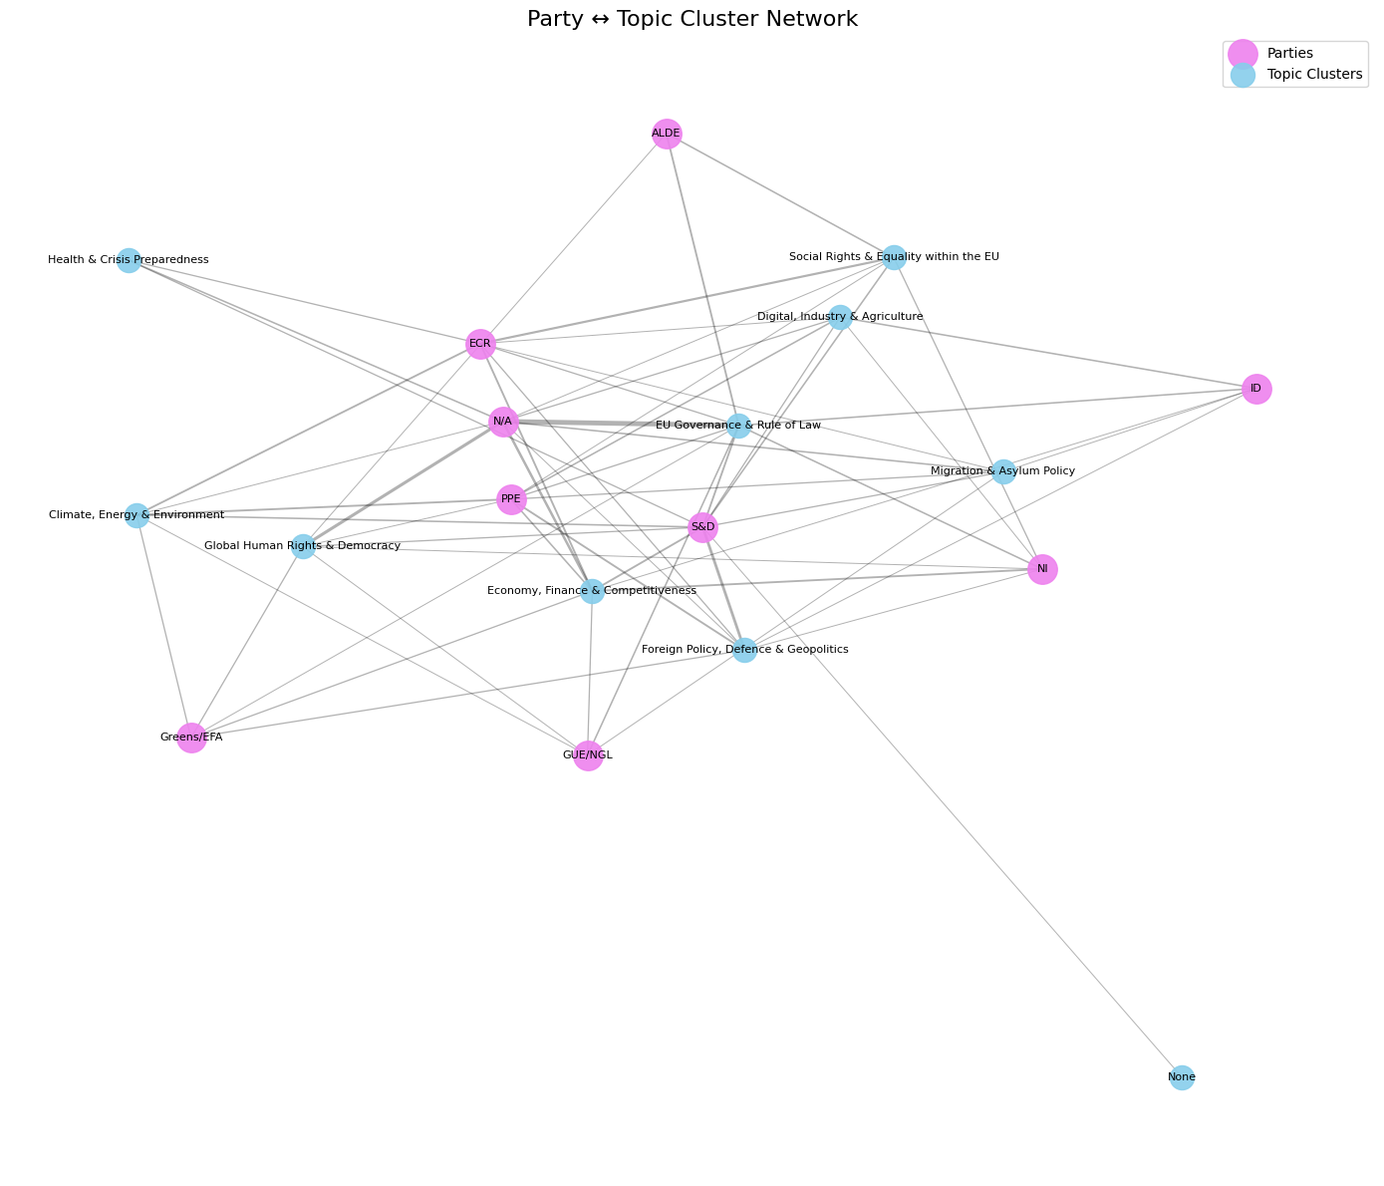
How parties focus
Analysis & Results
What it represents
Three-mode network combining political groups, individual speakers, and thematic clusters.
Visualizes how parties allocate speaking activity across issues.
Key insights
S&D emerges as the most central and thematically diversified group.
PPE and ECR also maintain strong cross-cluster presence.
Non-attached (N/A) members unexpectedly generate high speech volumes.
Bridge topics – Governance, Economy, Human Rights – connect multiple parties, revealing both polarization and consensus zones.
Notes:
* S&D is the most central party across all measures — the most connected (degree), most influential bridge (betweenness), and closest to the entire debate structure (closeness)
* Non-attached members (N/A), PPE, and ECR also play significant structural roles, though with different profiles (e.g., volume vs. connectivity).
On the thematic side:
* EU Governance & Rule of Law, Economy & Competitiveness, Human Rights, and Foreign Policy consistently appear as the central hubs of debate, scoring highly on degree, weighted degree, betweenness, and closeness.
* These issues form the backbone of the 2023 European Parliament agenda, serving both as high-volume topics and as conceptual bridges between political party groups.
The combination of high-connectivity clusters and active/broker parties creates a network structure where a few key actors and themes dominate and organize parliamentary discourse.

Slide 9
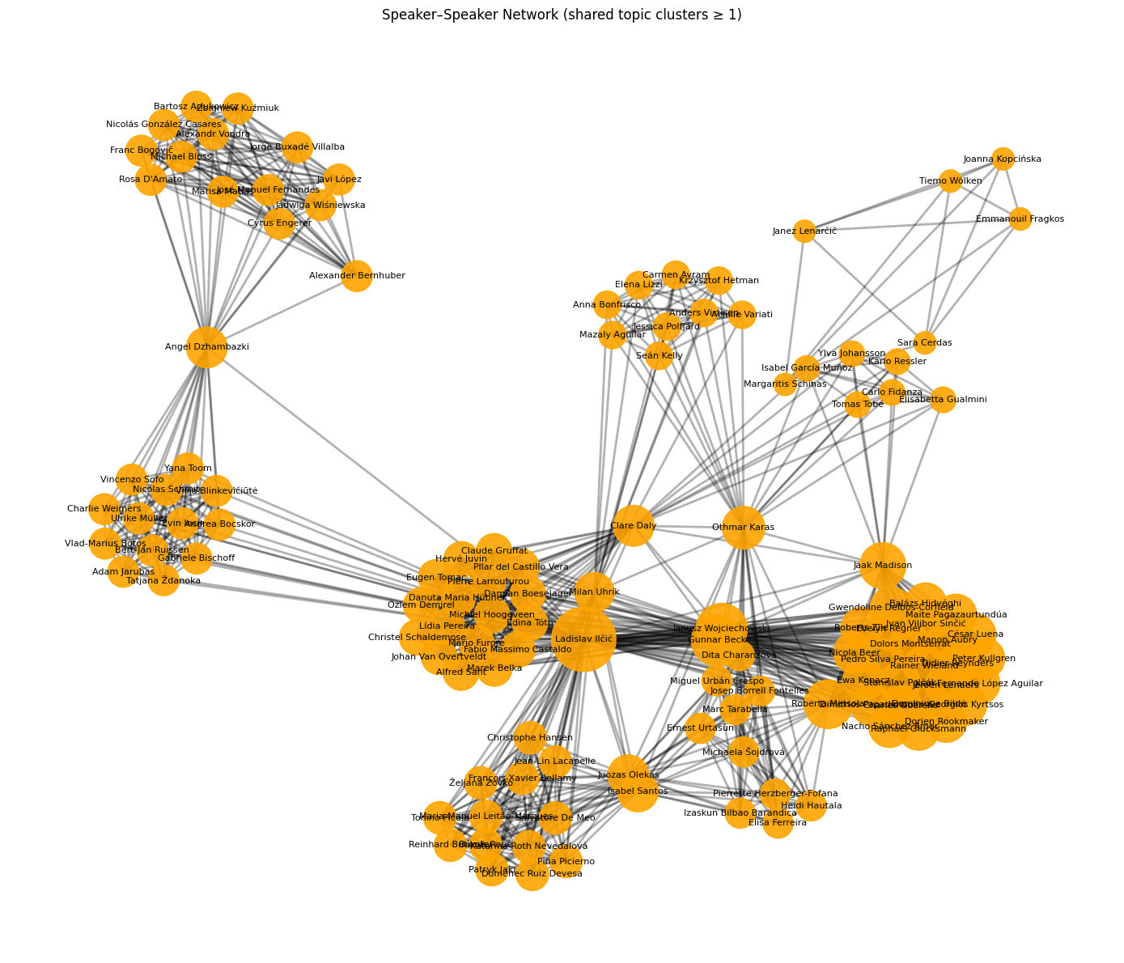
Who aligns with whom
Analysis & Results
What it represents
One-mode projection linking MEPs who share topic clusters.
Captures similarity of issue portfolios and informal thematic alliances.
Key insights
Ladislav Ilčić again ranks as the most central node across all measures.
Other major bridges: Angel Dzhambazki, Othmar Karas, Milan Uhrík, Roberta Metsola.
Clear community clusters form around thematic interests; bridge speakers link otherwise disconnected groups → key “information brokers” in the debate ecosystem.
Notes:
across all four centrality measures — degree, strength, betweenness, and closeness — Ladislav Ilčić is consistently the most central and influential speaker in the network.
This means Ilčić is:
* the most connected (degree)
* the most active in shared-topic discussions (strength)
* the key bridge connecting different groups (betweenness)
* the most globally accessible in the speaker discourse space (closeness)
Other highly central speakers include:
* Janusz Wojciechowski
* Gunnar Beck
* Roberta Metsola
* Jaak Madison
These speakers collectively form the core of the European Parliament’s 2023–24 debate structure, acting either as generalists, hubs, or bridges.

Slide 10

Key limitations of our analysis
Limitations
 | Limitations
 | High LLM failure rate: 335/500 speeches had no topics extracted.
 | Inconsistent topic quality (some too generic, some missing).
 | Language variation lowered accuracy.
 | Procedural speeches produced noise (no meaningful topic).
 | Irregular translations affected topic extraction.
 | Entity inconsistencies (speaker/party not standardized).
 | Reduced usable dataset → smaller, weaker networks.
 | Networks depend entirely on LLM performance.
Notes:
LLM failure rate: 335/500 speeches had no topics extracted. Inconsistent topic quality (some too generic, some missing). Language variation lowered accuracy. Procedural speeches produced noise (no meaningful topic). Irregular translations affected topic extraction. Entity inconsistencies (speaker/party not standardized). Reduced usable dataset → smaller, weaker networks. Simplified topic schema (1 primary topic only). Networks depend entirely on LLM performan

Slide 11

Conclusion
Insights
Debates revolve around a few dominant issue clusters
Party engagement patterns reveal both polarization and overlap
A few key MEPs act as cross-party connectors
Limitations
Data and Language Quality Issues
Reduced and Biased Dataset
Incomplete and Inconsistent LLM Extraction
Enhancements
Extend the scope over multiple years
Add sentiment and stance analysis
Scale the pipeline to the full EU debates dataset
Notes:
Insights
1️⃣ Debates revolve around a few dominant issue clusters
Topics like Governance, Economy, and Foreign Policy form the structural core of EU parliamentary discourse, attracting participation across nearly all parties.
2️⃣ Party engagement patterns reveal both polarization and overlap
Political groups differ in focus — Greens/EFA on environment, ECR on migration — yet share bridge issues such as human rights and rule of law where debates converge.
3️⃣ A few key MEPs act as cross-party connectors
High-centrality speakers like Ilčić, Metsola, and Dzhambazki link otherwise separate clusters, shaping how information and themes circulate across ideological lines.
Limitations
1️⃣ Data and Language Quality Issues
Multilingual input, uneven translations, and inconsistent entity naming (parties, speakers) introduced noise. These inconsistencies led to missing links and weaker cross-party comparability.
2️⃣ Reduced and Biased Dataset
After cleaning, only ~165 speeches remained—skewed toward longer interventions with richer topic content. This limits representativeness and makes centrality measures sensitive to a few highly active MEPs.
3️⃣ Incomplete and Inconsistent LLM Extraction
Roughly two-thirds of speeches produced no usable topics due to short or procedural content. Even among valid outputs, topic quality varied from precise (“banking regulation”) to overly broad (“policy”), reducing network reliability.
Enhancements
1️⃣ Extend the scope over multiple years
Include debates from additional parliamentary sessions to trace how political themes, alliances, and network structures evolve over time.
2️⃣ Add sentiment and stance analysis
Classify whether parties and speakers express support, opposition, or neutrality toward each topic to move from what is discussed to how it is discussed.
3️⃣ Scale the pipeline to the full EU debates dataset
Apply the LLM-based extraction to all available speeches to validate results, uncover rare themes, and strengthen the robustness of network insights.

Slide 12
Discussion
?
?!

Slide 13
Appendix

Slide 14
Developing model architecture for our networks
ADD CLUSTER
Pipeline & Network Architecture
Speaker
Speech/Interaction
Generated Topics and Cluster
Doc ID: 84
Speaker: Salvatore De Meo
Party: EPP
Mr. President, honorable colleagues, the failure of this debate and the true purpose of this debate are confirmed by the totalitarian absence of all the parliamentarians …
Topics: ['political instrumentalization' ‘national issues' 'family rights']
Primary Topics: political instrumentalization
Cluster: EPP
Doc ID: 104
Speaker: François-Xavier Bellamy
Party: EPP
We are talking about human rights in danger. They are this evening, in general indifference, in the Upper Karabakh. The Latchine road, the only possible access …
Topics: ['nagorno-karabakh blockade' 'humanitarian crisis']
Primary Topics: nagorno-karabakh blockade
Cluster: ALDE
Doc ID: 9
Speaker: Jean-Lin Lacapelle
Party: ID
– Mr. Commissioner, the EU resolutions and statements are constantly calling for the accession of Balkans to the European Union, including the territory of Kosovo. In the …
Topics: ['eu accession' 'western balkans' 'kosovo status']
Primary Topics: eu accession
Cluster: ID
Nodes
Edges
Core Networks
Speakers
Parties
Topics
Spoke about
Belongs to
Shares topics with
Speaker-Cluster
Party-Cluster
Speaker-Speaker

